Slide 1
IMDB Movie Analysis
Drive Link for the project- https://drive.google.com/drive/u/0/folders/1z6azyOrtJhOmBiMGLIH_SBJNiug1vEQF
Project By-
Mohd Faiz
faiz.mohd340@gmail.com

Slide 2
IMDB Movie Analysis- Project Description
This project aimed to find insights on IMDB movies including the most popular actor, most popular director, top movies based on profit, IMDB top 250, popular genres, etc.
Dataset is having 28 columns and 5044 rows.
Find Insights and create report for data-driven decision by answering the questions asked

Slide 3
Approach
Download the dataset and open in excel for analysis
Clean the datasets
Process the data to answer the asked questions
Use formulas, filters, pivot tables and other functions for finding insights
Create charts and graphs for easy and meaningful data representation
Create report and submit the project

Slide 4




Tech Stacks Used

Slide 5

Cleaning the Data
Findings & Insights
Removed empty rows, special characters, and duplicate values
Columns that were not relevant in finding insights were hidden
Before cleaning we had 5044 rows (including headings in first row)
After cleaning we have 3724 rows (including column headings in first row)
Notes:
Here, we are analyzing the movies with respect to gross collection, ratings, popularity, etc and many columns are not required in the dataset. like: color, director_facebook_likes, actor_ 1_facebook_likes, actor_2_facebook_likes,actor_3_facebook_likes, actor_2_name, cast_total_facebook_likes, actor_3_name, duration, facenumber_in_poster, content_rating, country, movie_imdb_link, aspect _ratio, plot_keywords. We have hidden those columns
We also saw that some columns have large percent of null values, we dropped such rows
Before cleaning we had 5044 rows (including headings in first row) After cleaning we have 3724 rows (including column headings in first row)

Slide 6
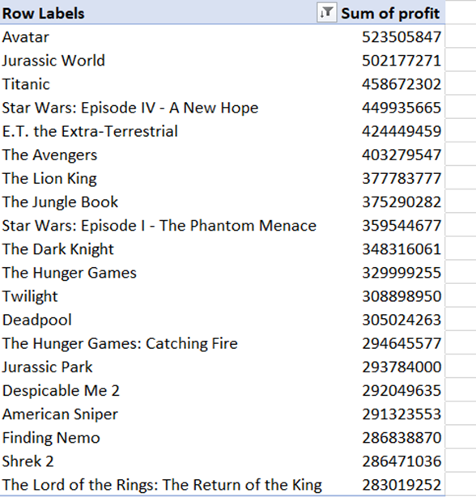
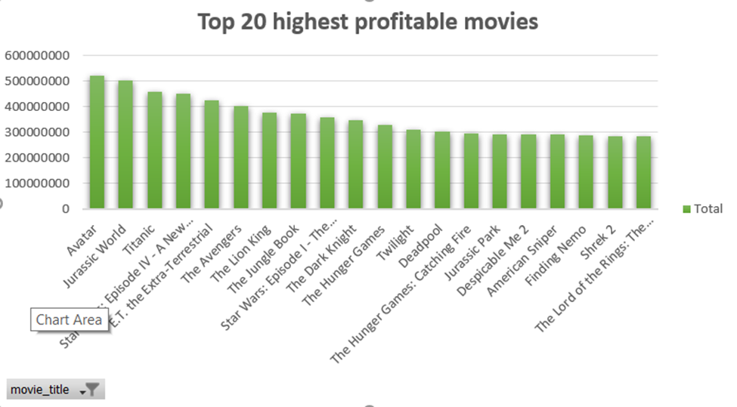
Movies with the Highest Profit
Created a Profit column by subtracting gross from the budget
Used a Pivot Table and sorted the top 20 movies
Created a chart for better visualization

Slide 7

Top 250
Extracted columns needed for a new sheet showing IMDB's Top 250 movies with votes>25000 and IMDB's Top Foreign language film

Slide 8
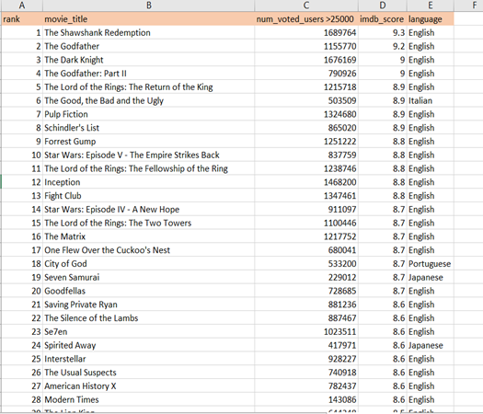
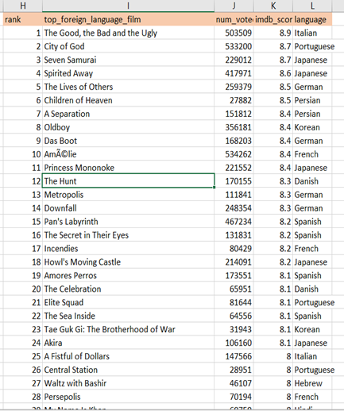
Top 250 IMDB Movies
Top Foreign Language Films
Notes:
Sort all the values by imdb_score in descending order
After that, filter the num_voted _users to more than 25,000
Extracted the top 250 movies in descending order and stored them in a new sheet
Extracted the non-English movies and stored them in a new sheet

Slide 9
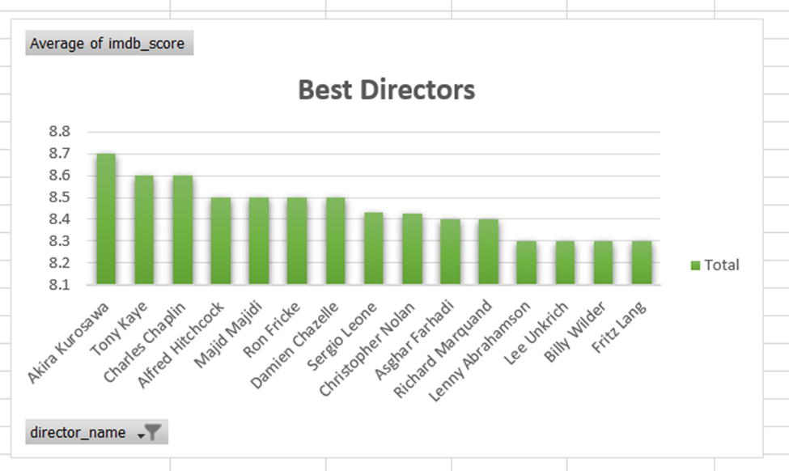
Best Directors
Best director is Akira Kurosawa with mean IMDB score of 8.7
Notes:
Used Pivot table and the grouping feature to find the top 20 directors with the highest mean of IMDB_score

Slide 10
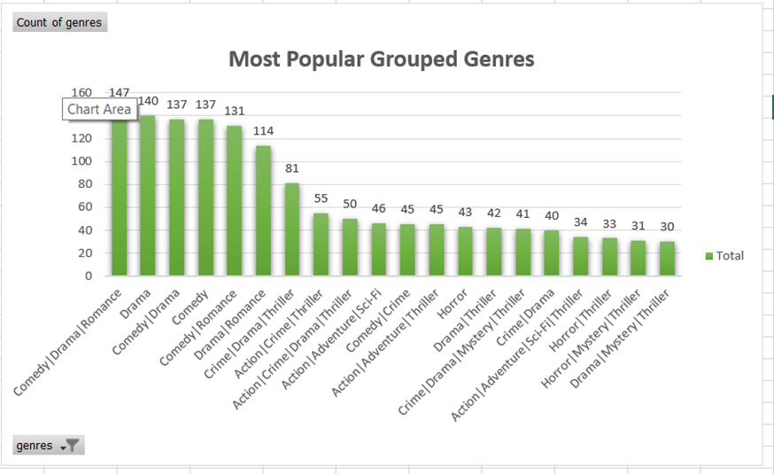
Popular Genres
Most popular grouped genre is Comedy|Drama|Romance
Notes:
Used Pivot table andthe grouping feature to find the count of grouped genres

Slide 11
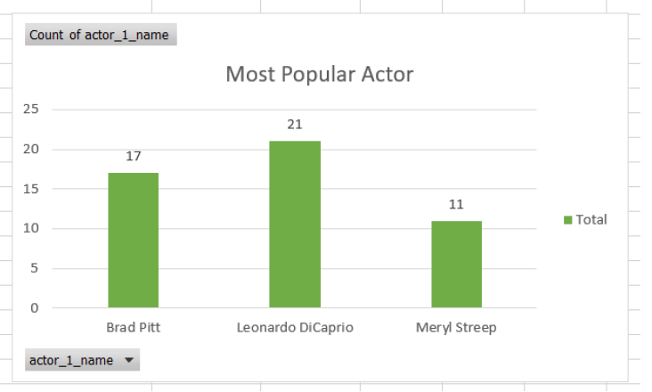
Most Popular Actor
Charts and Graphs for other insights
The most popular actor among Leonardo DiCaprio, Brad Pitt and Meryl Streep is Leonardo Dicaprio with 21 movies as a lead role.

Slide 12
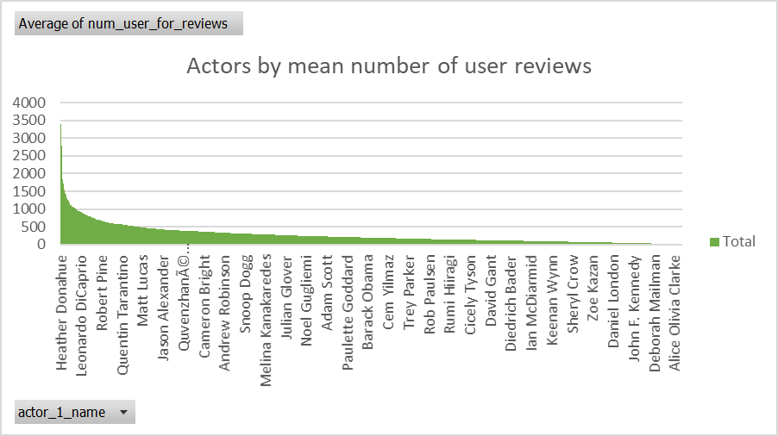
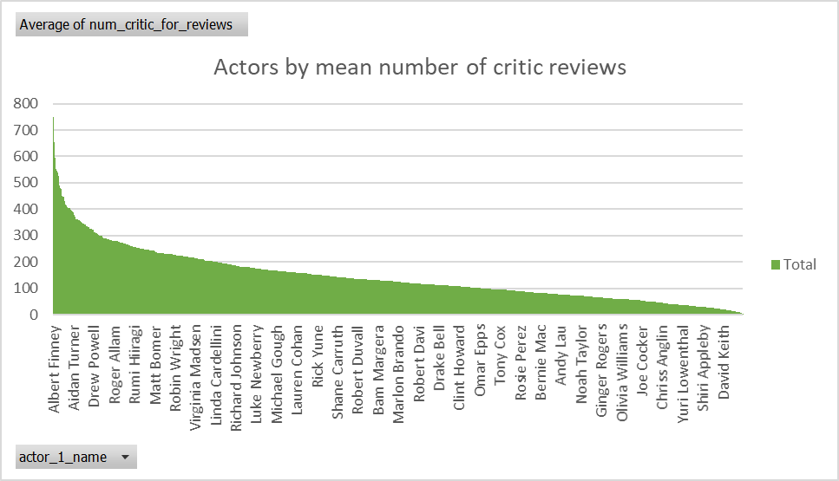
Most popular actor among audience
Most popular actor among critics
Notes:
Most popular actor by mean number of user reviews & mean number of critic reviews

Slide 13
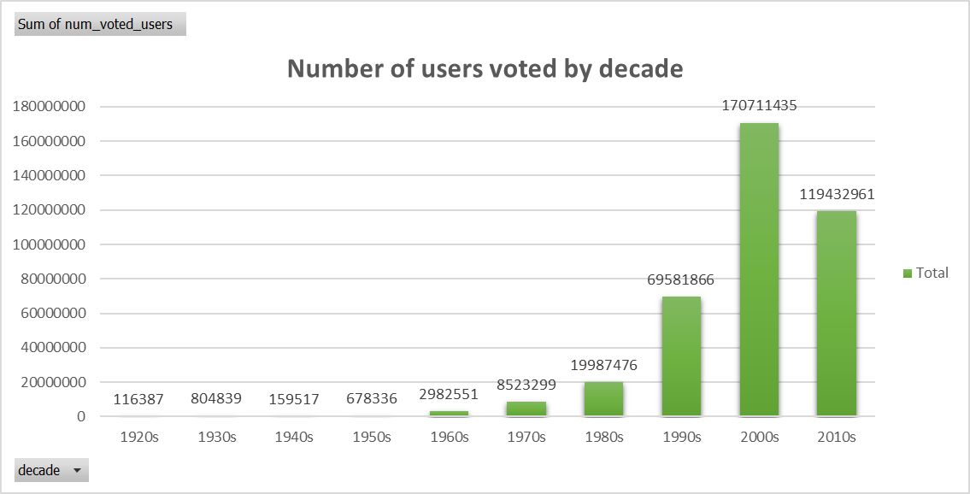
Most number of users voted by decade
In 2000s, most number of users have voted
In 1920s, least number of users have voted

Slide 14
Thank you for your time 😊

